Slide 1
E-commerce Website Database System
Course: Database Management System
Name : Bindhya Shakya
Date : 2081/10/04

Slide 2
Scenario Overview
An e-commerce company has recently decided to implement
a new database management system (DBMS) to handle various aspects
of their online store, including product catalog, customer information,
inventory management, and order processing. The company is moving
from a basic file-based system to a DBMS to better manage their
growing data, enhance customer experience, and streamline internal processes.
The main goal is to provide better product search capabilities, faster
order processing, and reliable customer support, all while ensuring
data consistency and security.
Questions
How would a DBMS help the company manage large volumes of customer
data, transactions, and product information more effectively than
a traditional file system?
Given that the company’s e-commerce platform needs to scale and
provide web access for thousands of customers, which architecture (one-tier,
two-tier, or n-tier) would be most suitable for their DBMS, and why?
How would a Database Manager (DBM) ensure that only authorized
personnel can access sensitive customer data (e.g., payment details,
addresses) while allowing employees to perform necessary tasks like
updating product availability?

Slide 3
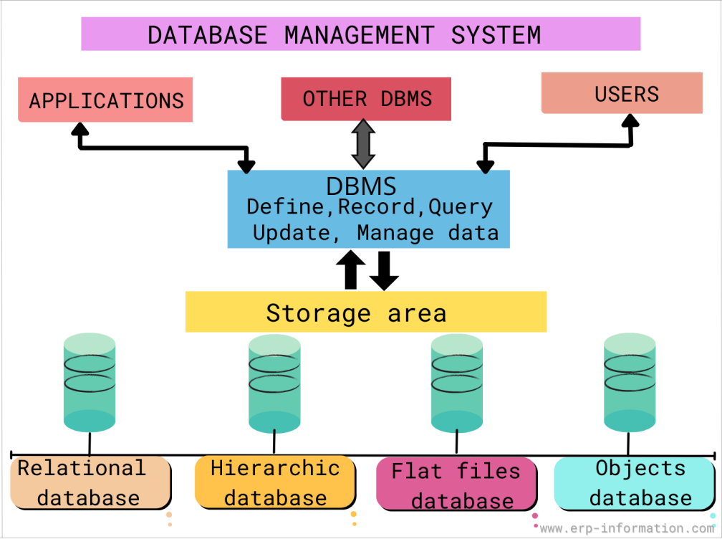
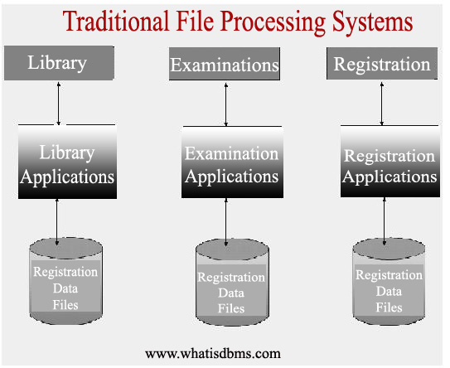
Database management system:
Database management system is a software system that manages & facilitates access to databases which also provides tools for creating , quering , updating,& managing data.
Traditional file system:
A Traditional file system is a software system which store and organize the data where information is kept in individual files.

Slide 4
1. DBMS help the company manage large volumes of customer data, transactions, and product information more effectively than a traditional file system for following reason:
a. Data Independence:
Reduced Data Redundancy: DBMS eliminates data duplication across different files, ensuring consistency and reducing storage space.
b. Enhanced Data Security:
Access Control: DBMS lets you control who can see and change what data ,based on their job or role within the company.
For example, a sales person might only see customer contact information, while an accountant might have access to financial data.
Data Encryption: Sensitive data like payment information can be encrypted within the database, adding an extra layer of security.
c. Improved Data Management:
Data Recovery: DBMS offers robust mechanisms for data backup and recovery, minimizing the risk of data loss due to hardware failures or accidental deletions.
Efficient Data Retrieval: DBMS uses smart shortcuts (like indexes) to quickly find the exact information you need, making online searches and operations much faster.
d. Scalability and Flexibility:
DBMS can easily accommodate growing data volumes and evolving business needs without significant system modifications.
Data Sharing: Multiple applications and users can access and share the same data within a controlled environment.

Slide 5
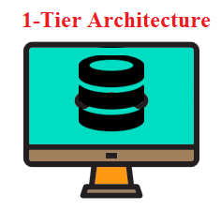
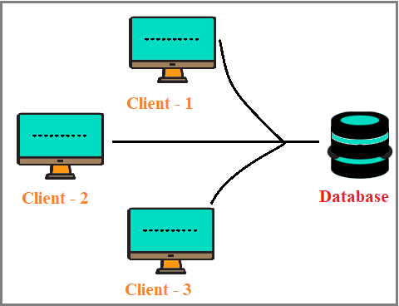
1-Tier Architecture
A single computer doing everything like storing data, processing information, and displaying results.
Limitations: Not suitable for sharing data or collaborating with others.
2-Tier Architecture
Two main parts:
Client: Your computer or device (like a phone) that requests information.
Server: A powerful computer that stores data and processes requests.
Limitations: struggle to handle a large number of users due to a single server constraints.

Slide 6
2. Suitable Architecture
For an e-commerce platform with thousands of concurrent users, a n-tier architecture would be the most suitable for the DBMS.
n-Tier Architecture: This architecture separates the application into multiple layers, such as:
Presentation Layer: Handles user interface and interactions (e.g., web browser).
Business Logic Layer: Contains the core business rules and application logic.
Data Access Layer: Interacts with the database to retrieve and store data.
Database Server: Houses the DBMS and manages data operations.
Benefits of n-Tier Architecture:
Scalability: Each layer can be scaled independently based on demand, improving performance and responsiveness.
Maintainability: The separation of concerns makes the system easier to maintain, debug, and upgrade.
Flexibility: New features and functionalities can be added more easily without affecting other parts of the system.
Improved Performance: Load balancing across multiple servers can distribute traffic and enhance overall performance.

Slide 7
3. Ensuring Data Security
A Database Manager (DBM) can implement several measures to ensure data security:
Role-Based Access Control (RBAC): Assign specific privileges (e.g., read, write, update, delete) to different user roles (e.g., administrators, customer service, sales).
Data Encryption: Encrypt sensitive data both at rest (within the database) and in transit (during data transmission).
Regular Audits and Monitoring: Monitor database activity for suspicious behavior and conduct regular security audits to identify and address vulnerabilities.
Strong Authentication: Implement robust authentication mechanisms (e.g., multi-factor authentication) to prevent unauthorized access.
Data Masking: For development or testing purposes, mask sensitive data to protect real customer information.

Slide 8



